Slide 1

PERIPARTUM CARDIOMYOPATHY
DR.T.NEELAMBUJAN,M.D.,DNB(CARDIO).,
CONSULTANT CARDIOLOGIST & INTERVENTIONALIST
SUNDARAM ARULRHAJ HOSPITAL
TUTICORIN
Notes:
Peripartum Cardiomyopathy is not an uncommon clinical condition. We see less of this in our clinical practice because it is underdiagnosed many a time. shall address some of the issues.

Slide 2
DYSPNEA – POST PARTUM
35/F – DOE ; 3 WKS AFTER DELIVERY
HTN DURING PREGNANCY
NO CARDIOVASCULAR DISEASE
O/E : B.P 110/70 mm Hg ; PR 105 /min LOW VOL
PERIPHERAL PULSES WELL FELT
RR 28/min. JVP 10 cm ;PEDAL EDEMA
Grade II PANSYSTOLIC MURMUR
LVS3 +
BILATERAL RALES
Notes:
This is a prototype clinical history of a case of PPCMP which we managed.

Slide 3

LIKELY CAUSES?
PERIPARTUM CMP
PULMONARY EMBOLISM
AORTIC DISSECTION
ACUTE MI
ANAEMIA WITH HF
Notes:
In a Patient ,presenting with dyspnea in the postpartum period without previous cardiac problem all the following conditions should be considered.
Not going into the detail of how to differentiate due to lack of time. Echocardiogram makes the life easy.

Slide 4
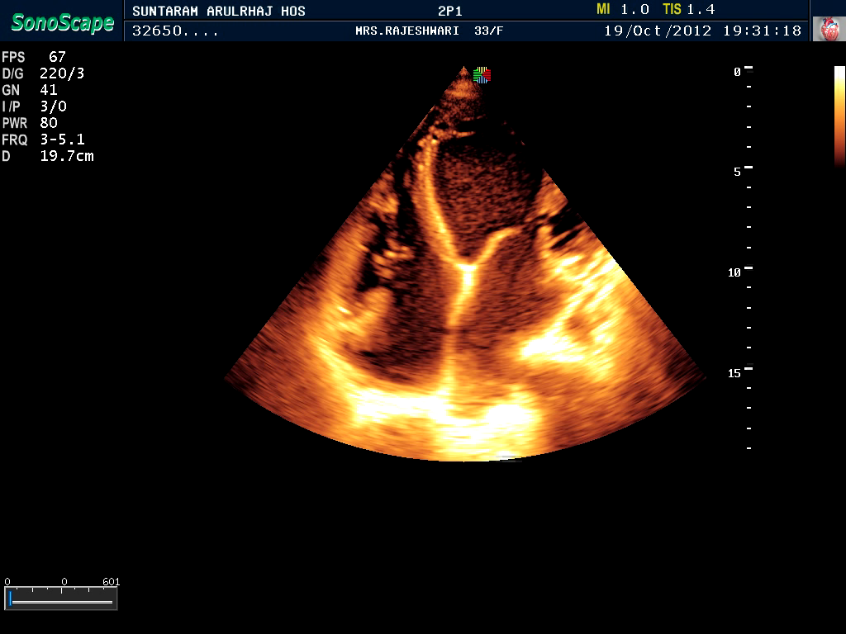
ECHO
Notes:
Dilated LV. Global hypokinesia of LV. Stasis of Blood in LV as shown by SEC.

Slide 5

PERIPARTUM CARDIOMYOPATHY
DEMAKIS et al- 1971 NAMED
DCM WITH SIGNS OF HF IN THE LAST MONTH OF PREGNANCY OR WITHIN
5 MONTHS OF DELIVERY
INCIDENCE VARIES
Notes:
Heart Failure during Pregnancy has been described in literature as early as 1849. But it was Demakis who named the syndrome as PPCMP in 1971.
European society of Cardiology defined it as a DCM with signs of the HF in the last month of Pregnancy or within 5 months of delivery.The incidence of PPCMP is around 1 in 3000 live births.

Slide 6
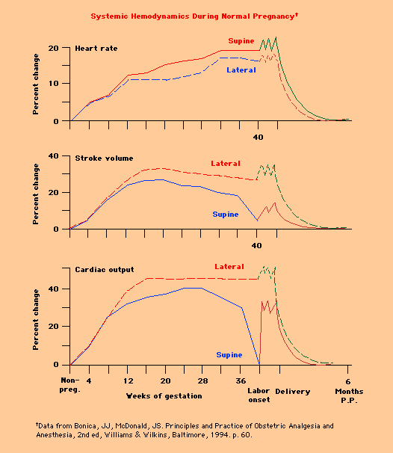
TIMING OF DIAGNOSIS
DX. REQUIRES BEING IN THE LAST MONTH OF PREGNANCY
IF EARLIER, CONSIDER OTHER HEART DISEASE (ISCHEMIC, VALVULAR, OR MYOPATHIC)
2ND TRIMESTER BURDEN
Notes:
The timing of the Diagnosis is important. Diagnosis requires being in the last month of Pregnancy.If it is diagnosed earlier other cardiac problems like valvular,ischaemia or dilated cardiomyopathy should be considered). Eventhough the pathology starts earlier the increase in HR,increase in stroke volume and cardiac output in the second trimester leads to the clinical presentation in the last month of Pregnancy.

Slide 7
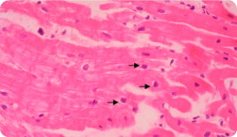
WHAT CAUSES IT?
MYOCARDITIS
OLDEST THEORY
ENDOMYOCARDIAL BIOPSY
VARIABLE PREVALENCE
Notes:
Myocarditis has been identified by Endomyocardial biopsy in Patients with PPCMP demonstrating a dense lymphocyte infiltrate and variable amounts of myocyte edema,necrosis and fibrosis.The prevalence of this finding is also variable from 8% to 78% raising doubts whether Myocarditis has a causal role or just an associated finding!

Slide 8
PATHOLOGIC IMMUNE RESPONSE
VIRAL INFECTION & PATHOLOGIC IMMUNE RESPONSE AGAINST VIRAL ANTIGENS
CROSS REACTS WITH NATIVE CARDIAC TISSUE PROTEINS
PARVOVIRUS B19; HUMAN HERPES VIRUS 6;
EBV; CMV
Notes:
After a cardiotrophic viral infection ( Parvovirus B19,Human herpes virus 6,EBV and CMV ) a pathologic immune response against these viral antigens might cross react against native cardiac tissue proteins and cause LV dysfunction.This is just like RHD.

Slide 9
CHIMERISM
CELLS FROM FETUS COLONIZE IN MOTHER PROVOKING IMMUNE RESPONSE
AUTOANTIBODIES AGAINST CARDIAC TISSUE PROTEINS IN HIGH TITRES
APOPTOSIS
APOPTOSIS OF CARDIAC MYOCYTES
ROLE OF Fas and Fas LIGAND
Notes:
Chimerism is a Phenomenon wherein the cells from the fetus pass into the maternal circulation and colonize in the heart provoking an immune response.This theory is supported by the presence of High titres of Autoantibodies against the cardiac tissue proteins in patients with PPCMP.
Apoptosis of the cardiac myocytes has been proposed as one of the cause of PPCMP.Fas and Fas Ligand has been suspected to play a key role in the process of Apoptosis.

Slide 10
ROLE OF PROLACTIN
CARDIOMYOCYTE DELETION OF stat3
ENHANCED CARDIAC CATHEPSIN D
PROTEOLYTIC CLEVAGE OF PROLACTIN INTO 16KDa PRL FRAGMENT
16KDa PRL FRAGMENT- PROINFLAMMATORY,
PROAPOPTOTIC & ANTIANGIOGENIC
Notes:
In Genetically Predisposed mice Cadiomyocyte specific deletion of Stat 3 gene has been demonstrated.This leads to enhanced expression and activity of Cardiac Cathepsin D. Cathepsin D leads to Proteolytic clevage of Prolactin into 16 Kda Prolactin Fragment.This 16KDa Prolactin fragment is Proinflammatory,proapoptotic and antiangiogenic leading to LV Dysfunction and PPCMP.

Slide 11

OTHER POSSIBLE FACTORS
SELENIUM DEFICIENCY
RELAXIN
CARDIAC DYSTROPHIN
IMMATURE DENDRITIC CELLS
CARDIAC NO SYNTHASE
HARMONE- PROGEST,PRL,OESTROGEN
HAEMODYNAMIC STRESS OF PREGNANCY
FAMILIAL

Slide 12

WHO IS AT RISK?
AGE >30 YEARS
MULTIPARITY
MULTIFETAL PREGNANCY
GESTATIONAL HTN
LONG TERM TOCOLYTIC Rx
RACIAL
COCAINE ABUSE
Notes:
One should know who is at Risk of this Problem so that we can anticipate it during the course of Pregnancy. Clinically more relevant ones are on the left side.Maternal age > 30 . Multiparous woman.Multifetal pregnancy. Gestational HTN.Longterm Tocolytic Treatment has also been considered as a risk factor for PPCMP.

Slide 13
CLINICAL PRESENTATION
SYMPTOMS
  PND
  DOE
  COUGH
  ORTHOPNEA
  CHEST PAIN
  ABD DISCOMFORT
  PALPITATION
  THROMBOEMBOLISM
  HAEMOPTYSIS
  SCD
SIGNS
  CARDIOMEGALY
  GALLOP RHYTHM
  EDEMA
  MURMUR
UNEXPLAINED SYMPTOMS
HEIGHTENED SUSPICION
LATENT CMP
Notes:
Clinical presentation varies. Various symptoms with decreasing order of frequency is given.PND is the commonest presentation. PND is also highly specific for HF. Rare presentations like CVA and peripheral embolism due to Thromboembolism can occur.Catostrophic presentations like SCD due to arrhythmia has been reported. consider PPCMP in any Peripartum patient with unexplained symptoms.The symptoms of HF may be difficult to differentiate from those of late pregnancy, a high suspicion can help.

Slide 14
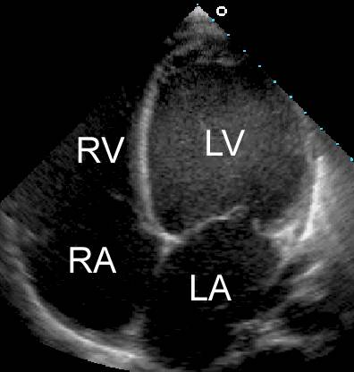
ECHOCARDIOGRAM
SPHERICAL LV
MITRAL AND TRICUSPID REGURGITATION
LEFT ATRIAL ENLARGEMENT
EF <45%
Notes:
If you have a clinical suspicion of PPCMP, do an Echocardiogram which will give you the diagnosis.In PPCMP we may have the above findings.

Slide 15

LABORATORY EVALUATION
HB
RENAL PARAMETERS
ELECTROLYTES & CALCIUM
TSH
BNP LEVELS
TROPONIN LEVELS
Notes:
Hb,Renal Parameters and Electrolytes help in the management of HF.TSH screening should be done in all patients.A low TSH might give a clue about Hyperthyroidism which might worsen the HF.Assessment of BNP levels is the more Scientific way of managing the HF.It helps to tailor the antifailure therapy.Troponin levels are used in prognostication.

Slide 16
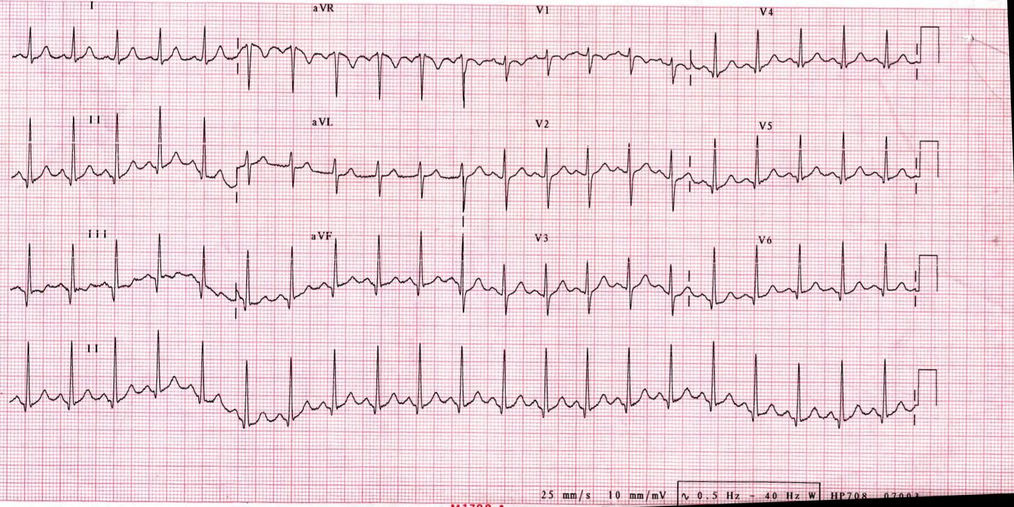
ECG
SINUS TACHYCARDIA
NONSPECIFIC ST CHANGES
LVH
Notes:
ECG may not be diagnostic. But helps to R/o other causes with similar presentation like AMI.Ecg usually shows the above findings.

Slide 17
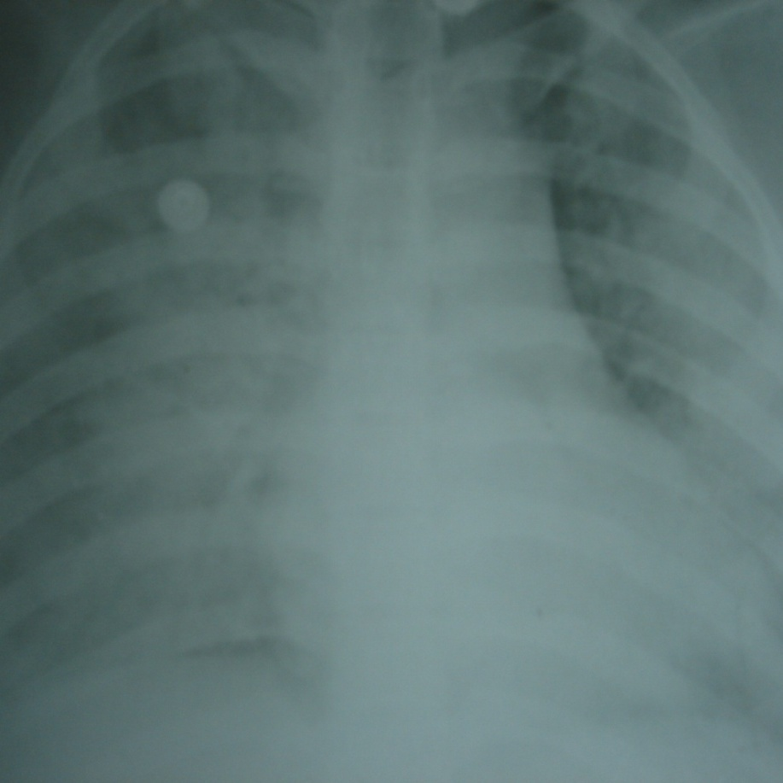
CHEST X-RAY
PULMONARY EDEMA
VENOUS CONGESTION
CARDIOMEGALY
Notes:
CXR very useful in diagnosing HF especially in patients presenting in the postpartum period.

Slide 18
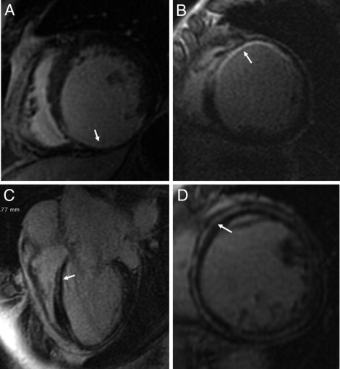
CARDIAC MRI
DELAYED CONTRAST ENCHANCEMENT (GADOLINIUM)
CHARACTERIZE MYOCARDIUM & DIFFERENTIATE TYPE OF MYOCYTE NECROSIS
GUIDE BIOPSY
ASSESS LV FUNCTION
Notes:
The Delayed contrast enchancement with Gadolinium helps to differentiate the type of Myocyte necrosis ( Myocarditis and Ischaemic ) and characterise the myocardium.Cardiac MRI is also useful to Guide the endomyocardial biopsy to abnormal area rather than blind biopsy.(The present guideline does not recommend routine Endomyocardial biopsy).

Slide 19
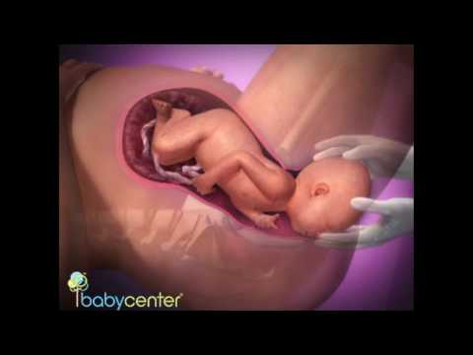
HEART FAILURE Rx – PREGNANCY
WELFARE OF FETUS & MOTHER
CO-ORDINATED MANAGEMENT
FETAL HEART MONITORING- ADVISABLE
ACEI & ARBs -CONTRAINDICATED
DIG,BB,NITRATES & HYDRALAZINE- SAFE
LOOP DIURETICS-CAUTIOUS USE
ELECTIVE LSCS-MOST CASES
Notes:
ACE I and ARB are contraindicated because of risk of fetal hypotension, Renal tubular dysplasia and oligohydramnios.

Slide 20

HEART FAILURE Rx- POSTPARTUM
IDENTICAL TO NONPREG WITH DCM
DIURETICS – SYMPTOM RELIEF
DIGOXIN – REDUCES HOSPITALISATION
ACEI & ARBs – MAXIMUM DOSE
BB-CARVEDILOL & METAPROLOL
HOW LONG TO TREAT?

Slide 21
ANTICOAGULATION
RISK OF THROMBOEMBOLISM HIGH
ARTERIAL,VENOUS & CARDIAC
WHO SHOULD RECEIVE ?
SEVERE LV DYSFUNCTION
DOCUEMENTED LV CLOT
H/O SYSTEMIC EMBOLISM
AF
Notes:
The risk of Thromboembolism is high during Pregnancy and during immediate postpartum period. This can lead to arterial,venous and cardiac thrombosis.When you have an associated cardiac problem the risk of thromboembolism is higher!pts with Severe LV Dysfunction. Those with LV clot,Those with H/o systemic embolism and AF should be started on Anticoagulant.

Slide 22
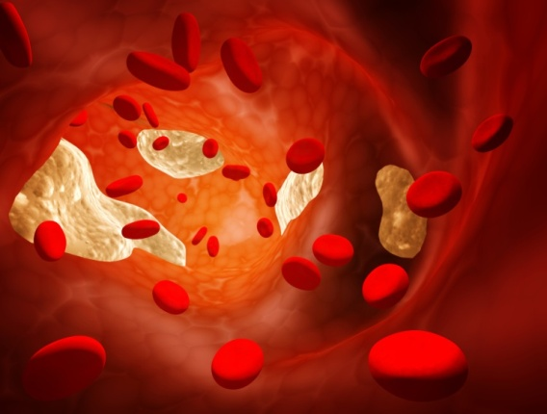
WARFARIN & HEPARIN
WARFARIN SAFE AFTER FIRST TRIMESTER
SWITCH TO UFH FOR PLANNED DELIVERY
UNPLANNED DELIVERY ON WARF-LSCS
MONITOR PT/INR VALUES
ROLE OF DABIGATRAN
Notes:
Warfarin is basically safe after first trimester and can very well be used for PPCMP when indicated.But warfarin must be switched to UFH before a planned delivery. If an unplanned delivery happens while on Warfarin LSCS is mandated to avoid the risk of fetal haemorrhage.when using warfarin monitor the PT and INR values atleast once in a month. Dabigatran is a new drug

Slide 23
NEWER TREATMENT
IV IMMUNOGLOBULINS
IMMUNOSUPPRESSIVE
BROMOCRIPTINE
MONOCLONAL ANTIBODIES
INTERFERON BETA
THERAPEUTIC APHERESIS
NONSPECIFIC IMMUNOADSORPTION
Notes:
Immunosuppresive therapy in proven myocarditis cases. Bromocriptine inhibits the Prolactin secretion and is a new therapeutic target.

Slide 24
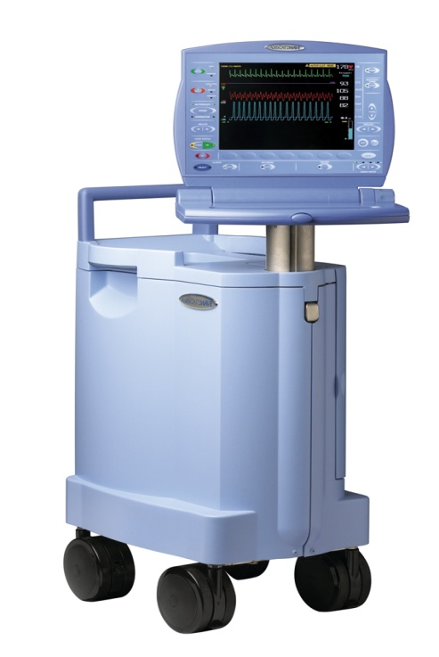
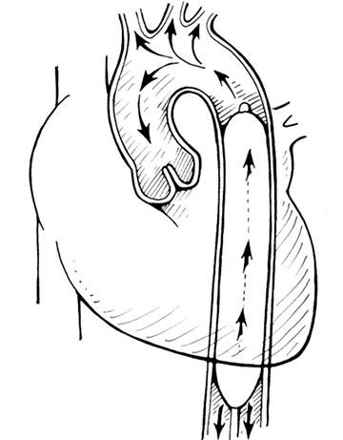
IABP
Notes:
With rapid strides in the field of interventional cardiology ,aggressive management of Acute HF is Warranted.IABP is lifesaving in pts with severe HF and cardiogenic shock.

Slide 25
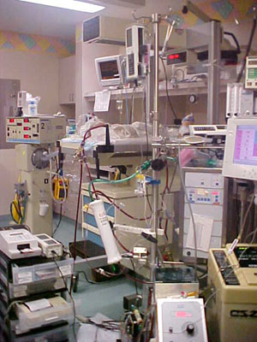
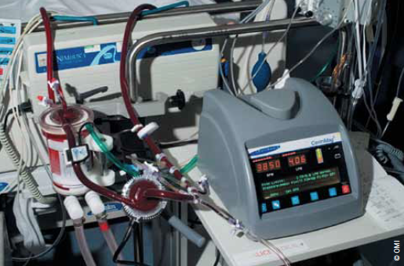
ECMO
Notes:
ECMO is cardio-pulmonary bypass pump used to induce Hypothermia and Oxygenation. This is very useful in severe Moribund Pts with HF.

Slide 26

NATURAL COURSE
BETTER SURVIVAL RATES
94% SURVIVAL AT 5 YEARS
54% RECOVERED NORMAL LV FUNCTION
( Elkayam et al )
LV FUNCTION RECOVERS > 6 MONTHS
RECOVERY MORE LIKELY -LVEF > 30%
Notes:
Among Pts with DCM ,PPCM has got better survival rates with 94% survival rates at 5 years with todays treatment.In one of the studies by elkayem et al 54% recovered LV function in 6 months time.LV function can also recover even after 6 months. Recovery of LV function is more likely if the LV EF is more than 30% at Presentation.

Slide 27
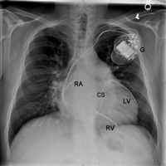
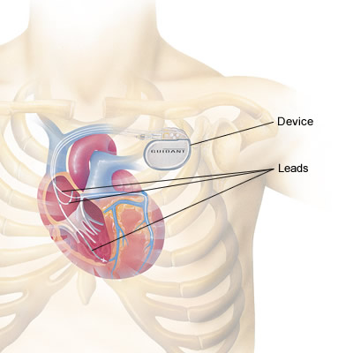
CRT
Notes:
In Pts with Resistant HF not responding to Medical management, a CRT ( cardiac Resynchronisation Therapy ) with Biventricular Pacing helps to optimise the LV function.

Slide 28
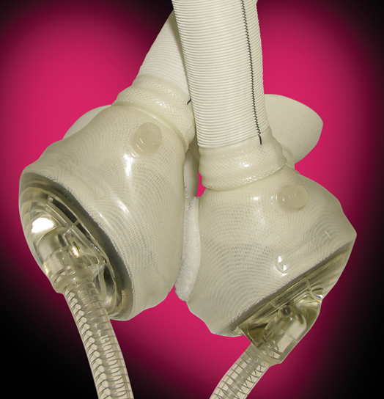
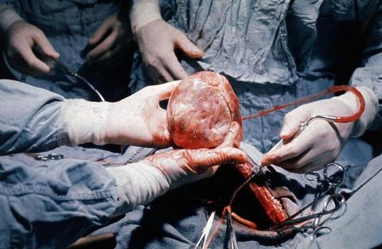
CARDIAC TRANSPLANT
ARTIFICIAL HEART
Notes:
Cardiac Transplanatation is of course the last resort and Before that Artificial Heart helps to bridge the Patient.

Slide 29

POOR PROGNOSTIC FACTORS
HIGH TROPONIN T LEVELS
QRS DURATION > 120 ms
LVEF < 30%
LVIDs > 5.5 cms
FS > 20%
LV THROMBUS
RACE

Slide 30
RISK OF RELAPSE?
LV FUNCTION COMPLETE RECOVERY-
PREG NOT CONTRAINDICATED ( LOW RISK )
LV FUNCTION PARTIAL RECOVERY-DSE
DSE NORMAL-PREG NOT CONTRAINDICATED
DSE ABNORMAL-PREG NOT RECOMMENDED
LV FUNCTION NOT RECOVERED-PREGNANCY CONTRAINDICATED (HIGH RISK)

Slide 31

POORLY UNDERSTOOD DISEASE
HEIGHTENED SUSPICION FOR EARLY DIAGNOSIS
AGGRESSIVE ACUTE MANAGEMENT
HOPEFUL OPTIONS FOR CHRONIC HF
RELAPSE- ACHILLES HEEL

Slide 32

THANK YOU

